Slide 1
Software Engineering Project
Beauty Center Application
Group members:
Adela Kaçorri
Adela Kondakçiu
Griselda Ramadani
Megi Lala

Slide 2
Identified problem: Overwhelming management when booking through direct messages on Social Media and phone calls.
Solution proposed:Proposing a quicker way for clients to make their appointments through the application according to their preferences. Helping workers manage their time and work.
Aim:
Create an application that can simplify the work of the employees
Go through the appointments made by the clients
Workers can check the scheduling shown in the app
Clients can decide which time is appropriate for them according to the scheduled calendar of available dates
Objectives:
Creating a functional application to book appointments
Registering the clients that want to book an appointment
Displaying the available time for each type of service
Displaying the reservations

Slide 3
Description of application:
The application will consist of:
General:
Main page: A short introduction of what the center offers, contact information
Photos: Works done by the nails and lashes technicians
For clients:
Register: Sign up option for clients by filling in information
Client Login: Once registered, log in option available
My Profile: Once logged in clients can have the possibility to see their profiles
Book Lashes and Book Nails: Calendar displaying only the current week and 2 upcoming weeks from the current date
My Reservations: All reserved appointments made according to the type of service
Logout: button to log out
For technicians:
N/L Technician Login
My Profile: General information and type of service offering
Client’s Reservation: Current week’s reservations
Logout: button to log out

Slide 4
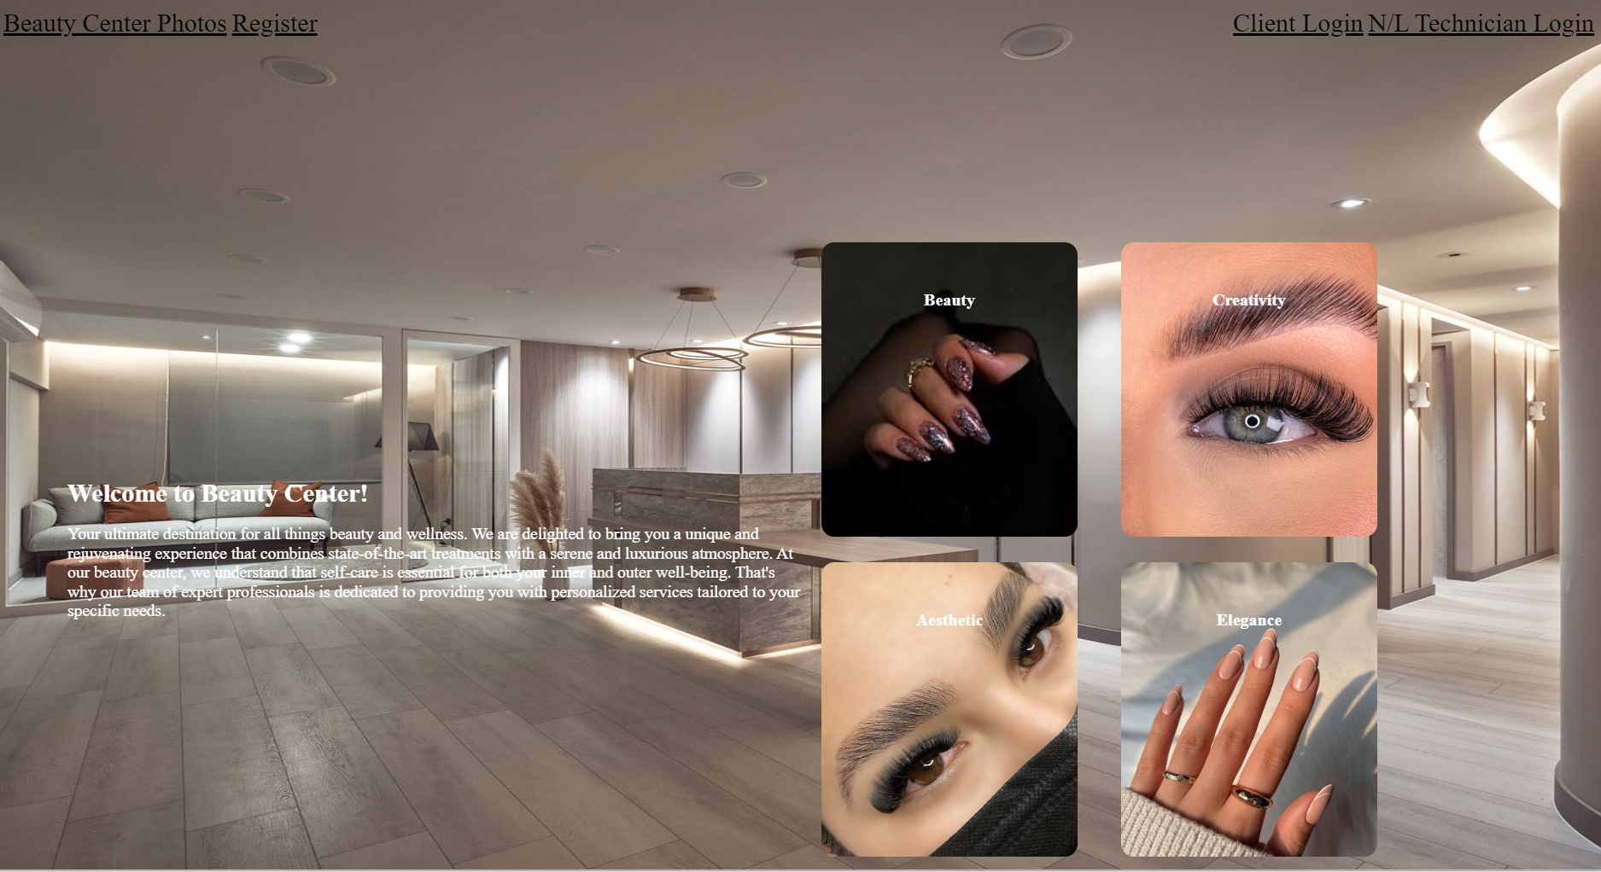

Slide 5
Development model:
Plan-driven model.
Users:
Nail and Lash Technician
Clients
User requirements:
- Clients: create an account by registering on the website
- Client and technician: Log in to their profile by their username/ email and password
Clients:
-Display the client’s information on their profile
-Display the schedule of each technician to book the preferred time by choosing the type of service.
-Display the previous, current and future appointments.
Technician:
-Display technician information on their profile
-Display the appointments that are reserved during the week

Slide 6
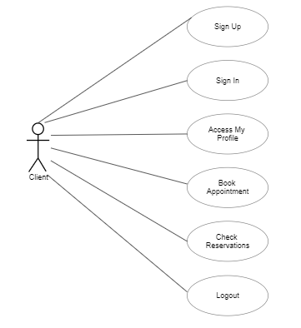
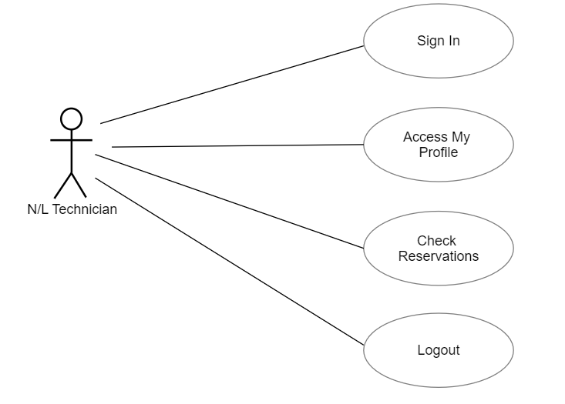

Slide 7
System requirements:
- Options of registering for new clients.
-For registration of the clients, the system will require to fill in the data including name, last name, username, date of birth, phone number, email address, password.
-For technician and client login, the system will require the username/email and the password to enter the profile by clicking the specified button.
-For each client, their profile information will be displayed including name, surname, date of birth, phone number and email address.
-For each technician, their profile information will be displayed including name, surname, email address, phone number and type of service they offer.
-For each week the system will generate for each technician a list of appointments specifying the name, last name of client, phone number, date and hour and ordering them from the earliest to latest.

Slide 8
Continue…
-In the clients page, there will be two buttons to select the type of service they want and after clicking, the available times will be shown.
-The calendar will display 3 weeks in total, including the current week and the 2 upcoming weeks from the current date of accessing the profile in the website.
- The system should automatically save the changes made by the users showing all the appointments available and those which are not.
-The system will show in the calendar past unreserved dates with blue color time slots marked as unavailable.
-The system will show in the calendar past, current and upcoming dates which have been reserved with red color time slots marked as unavailable.
-The system will show in the calendar current and upcoming dates which are not reserved yet with blue color time slots and the specific time shown inside the slot.

Slide 9
Non-functional Requirements:
The application should be easy to use.
The application should be supported by different types of browsers.
The application should be reliable.
The application should provide protection of clients’ data.
The application should be fast and provide the information quickly.
Application Specification:
Developed using scripting languages such as PHP, HTML, CSS and JavaScript
The application will provide an interactive and responsive user interface
The user interface will be simple and easy to use
It will provide a smooth experience for the clients wanting to book an appointment and see their reservations

Slide 10
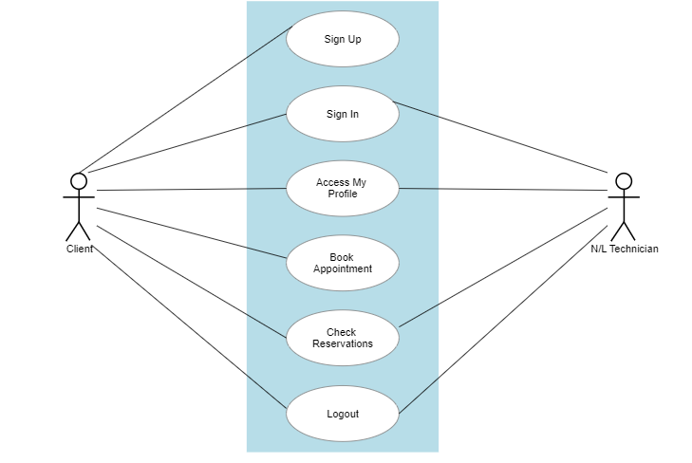
UML diagram
System Modeling:
Approach the application from the interaction perspective
Model the interactions between the components of a system

Slide 11
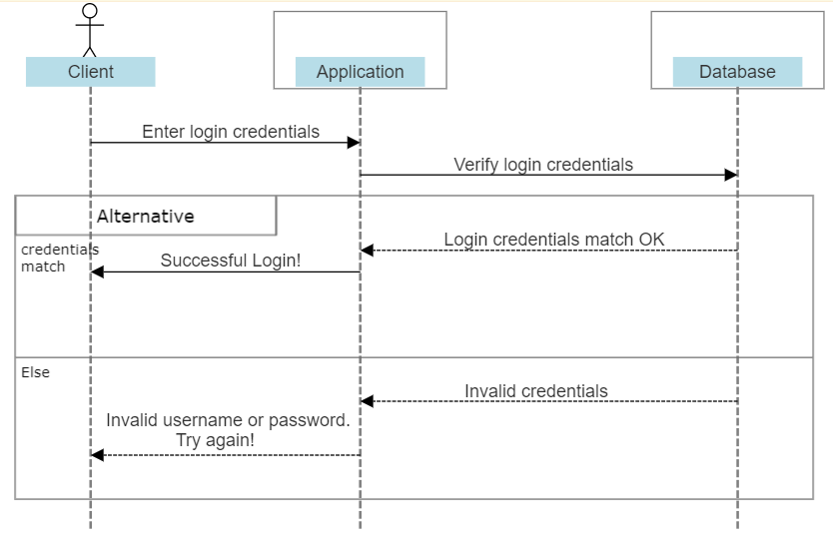
Sequence Diagram

Slide 12


